Slide 1
Systems Thinking
A Watershed learning network module
This material was generated as part of a collaboration between members of the Atlanta Watershed Learning Network and students and faculty of a service learning course in urban ecology. The views and opinions expressed in these materials are those of the authors and do not necessarily reflect the official policy or position of the University of Georgia.
Notes:
Welcome to the watershed learning network.
This material was based on a curriculum developed by members of the Atlanta Watershed Learning Network, led by Dr. Yomi Noibi of Eco-Action.
Unless otherwise noted, all of the diagrams and models used in the modules were created by Diane Kelment, the video material was captured and edited in large part by Allison Krausman, and the images used in the modules were taken by the students or instructor of the urban ecology course at UGA in 2018 or the West Atlanta Watershed Alliance.
The views and opinions expressed in these materials are those of the authors and do not necessarily reflect the official policy or position of the University of Georgia.

Slide 2
Understanding Urban Watersheds as Systems
Linking actors, outcomes, and their relationships
Notes:
Often, problems people face in urban watersheds are complicated. In order to learn how to engage in watershed governance, it can be helpful to think about the different elements affecting ecological, social, and economic conditions in urban watersheds. Therefore, it may be beneficial to think of urban watersheds as systems.

Slide 3
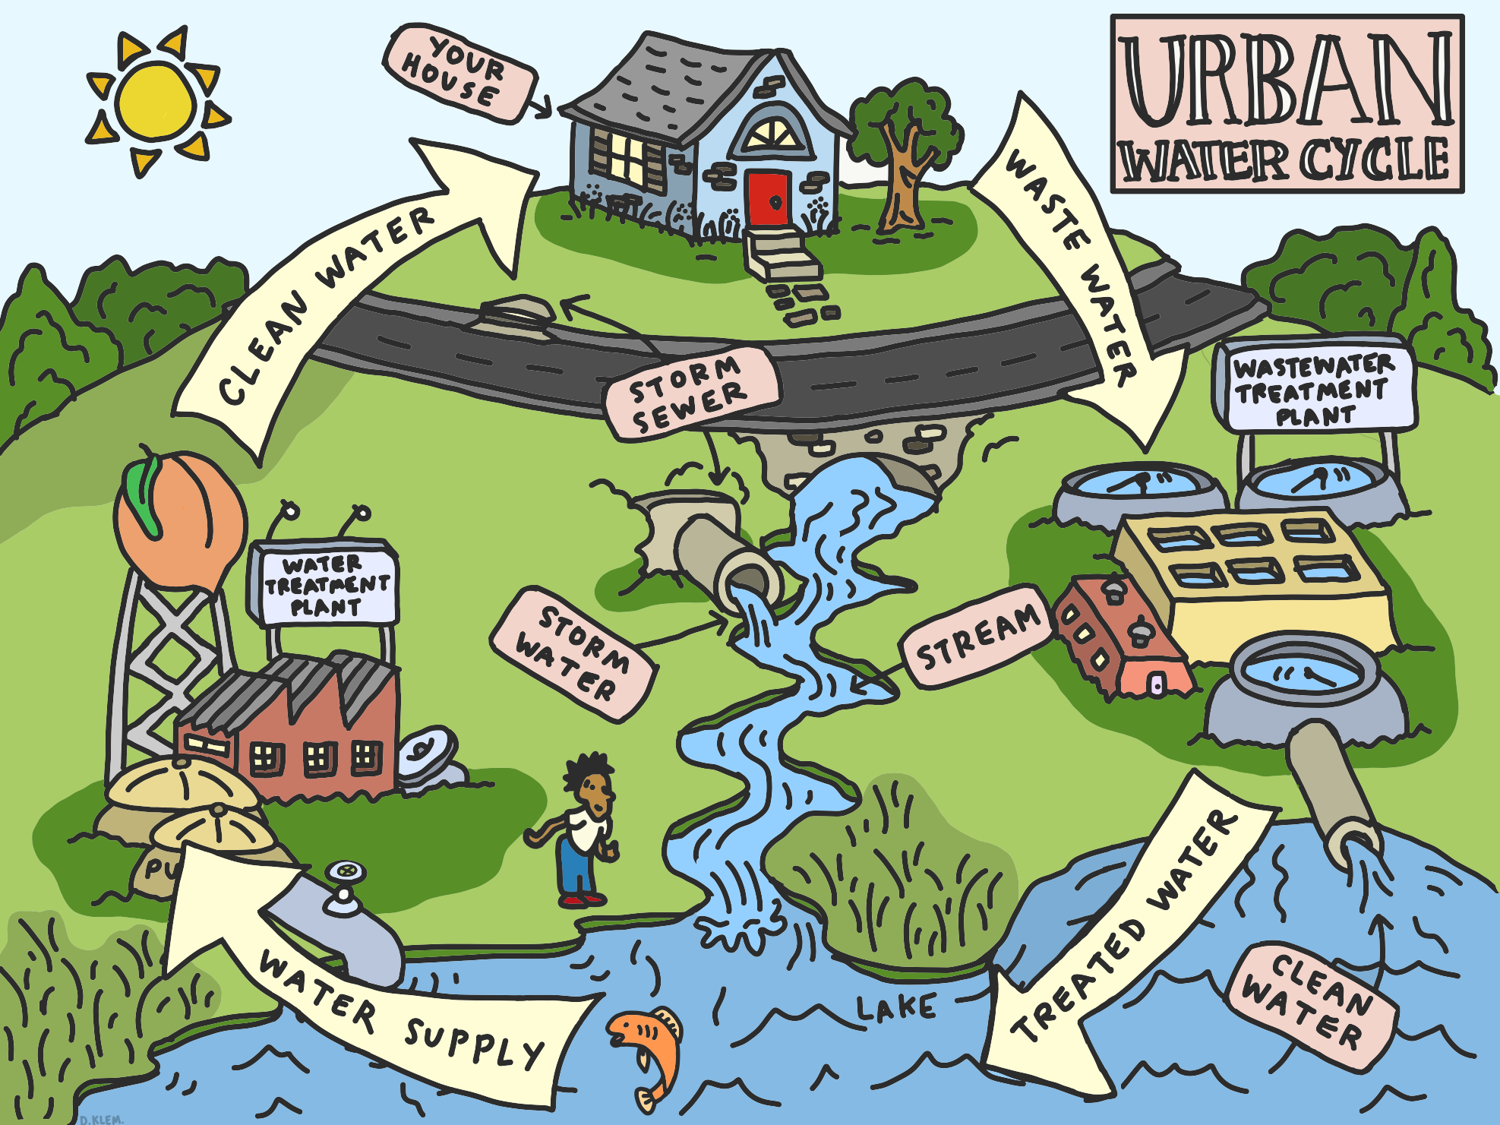
Notes:
The urban water cycle is complex. Water moves from groundwater, rivers, streams, and lakes into homes and businesses, is used by humans and flows back into the environment. In urban areas, precipitation from rain and snow storms falls on to roofs and ground that is often covered by pavement. Rather than percolating through soil and entering groundwater supplies, precipitation flows over land and can flood neighborhoods. Regulations governing environmental quality, and the age of a city’s infrastructure and rate at which a city is growing or shrinking interact with environmental conditions to create new watershed dynamics. Complex problems are often described as “wicked problems”.

Slide 4
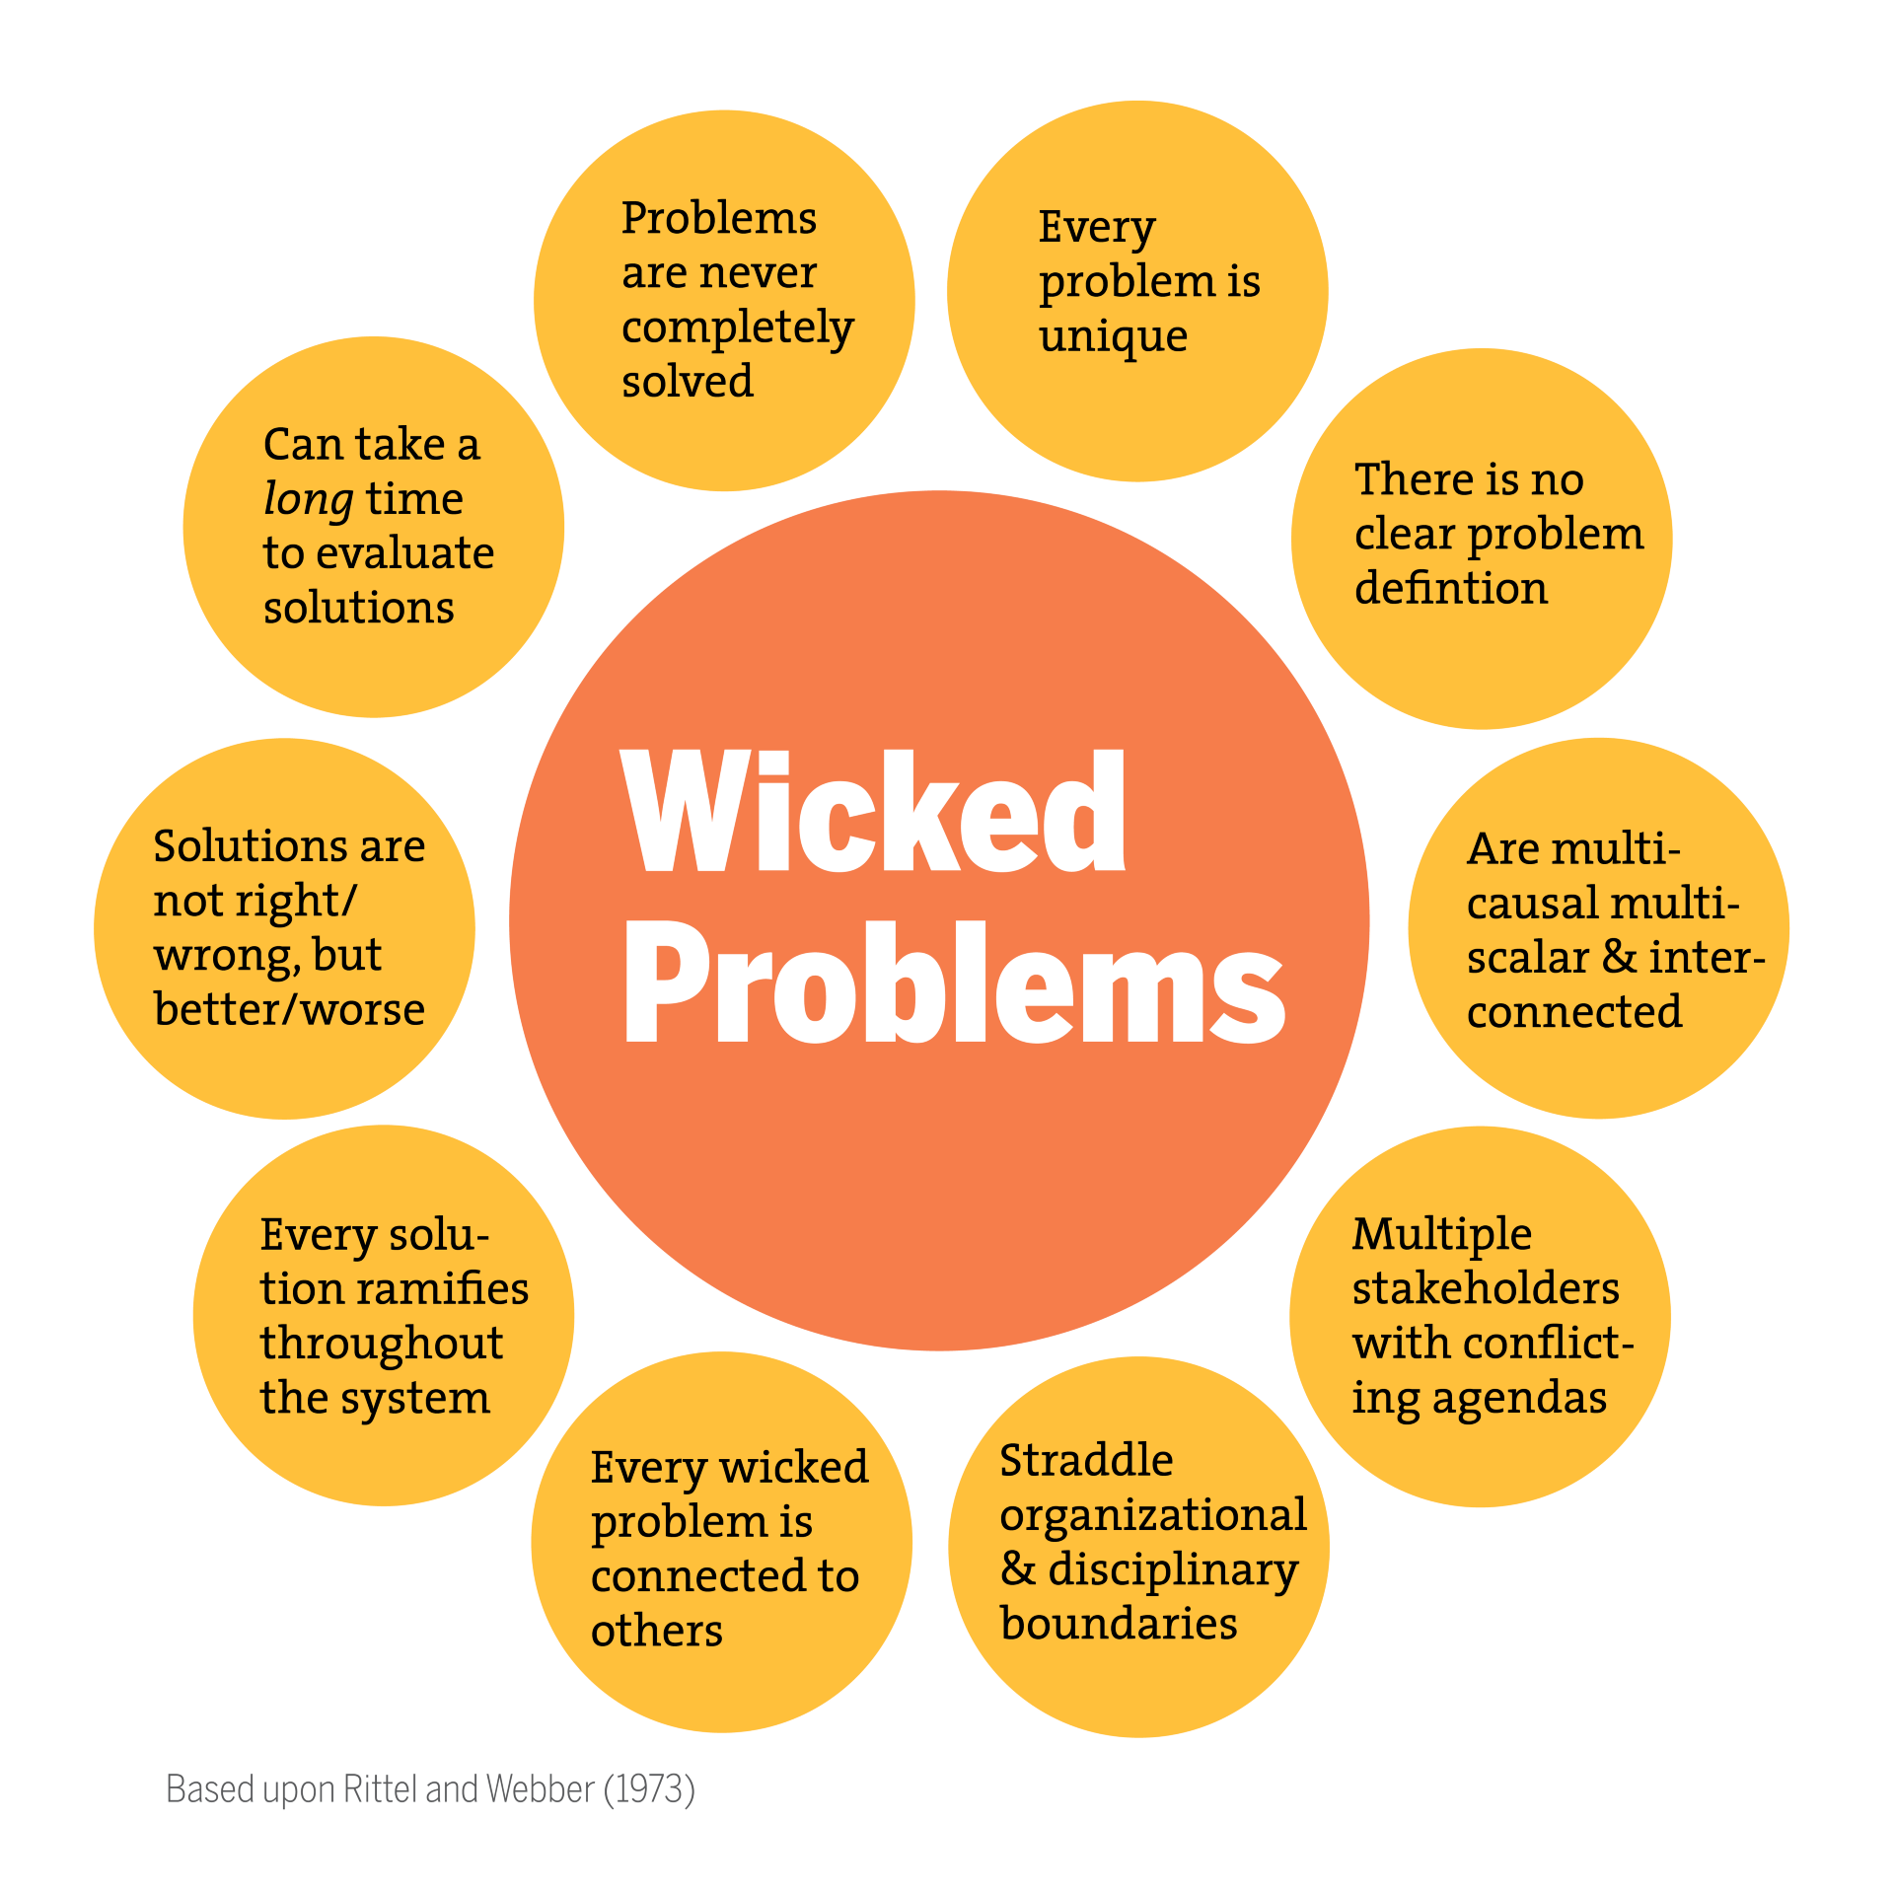
Wahl, 2017; modified from Rittel and Webber 1973
Notes:
. “A wicked problem is a social or cultural problem that is difficult or impossible to solve for as many as four reasons: incomplete or contradictory knowledge, the number of people and opinions involved, the large economic burden, and the interconnected nature of these problems with other problems.”¹
¹https://www.wickedproblems.com/read.php

Slide 5
What is a system?
“A system is an interconnected set of elements that is coherently organized in a way that achieves something.”
Anderson 1996; Meadows 2008; Arnold and Wade 2015
Notes:
In order to understand such complexity, it can be helpful to think of an urban watershed using a systems perspective.
Donna Meadows in her book, Thinking in Systems, defines a system as “an interconnected set of elements that is coherently organized in a way that achieves something.
Arnold and Wade (2015) A Definition of Systems Thinking: A Systems Approach (https://www.sciencedirect.com/science/article/pii/S1877050915002860)
Aronson, D. (1996) Overview of systems thinking. (http://resources21.org/cl/files/project264_5674/OverviewSTarticle.pdf)
Meadows, D. (2008). Thinking in Systems. Sustainability Institute, United Kingdom

Slide 6
What is a system?
“A system is an interconnected set of elements that is coherently organized in a way that achieves something.”
Element 2
Element 1
Element 4
What does the system do?
What does the system produce?
Element 3
Anderson 1996; Meadows 2008; Arnold and Wade 2015
Notes:
She argues if you look at that definition closely for a minute, you can see that a system must consist of three kinds of things: elements, interconnections, and a function or purpose.”
Thinking in systems can be advantageous when dealing with:
Complex problems that involve helping many actors see the “big picture”
Recurring problems or those that have been made worse by past attempts to fix them
Issues where an action affects (or is affected by) the environment surrounding the issue, either the natural environment or the competitive environment
Problems whose solutions are not obvious (Anderson, 1996)
These are often characteristics of issues with urban watershed management.
Systems thinking is a set of skills that can help people:
Identify the parts of a systems and how they are related
Predict what will happen in a system if a part of a system or an interaction within a system is changed
Understand how the system needs to be changed in order to change outcomes of the system (Arnold and Wade 2015)
In other words, systems thinking can help members of a community define a problem in an urban watershed, identify important environmental, governmental, and economic factors influencing their problem, and understand what changes need to be made to improve human well-being and the environment.
Arnold and Wade (2015) A Definition of Systems Thinking: A Systems Approach (https://www.sciencedirect.com/science/article/pii/S1877050915002860)
Aronson, D. (1996) Overview of systems thinking. (http://resources21.org/cl/files/project264_5674/OverviewSTarticle.pdf)
Meadows, D. (2008). Thinking in Systems. Sustainability Institute, United Kingdom

Slide 7
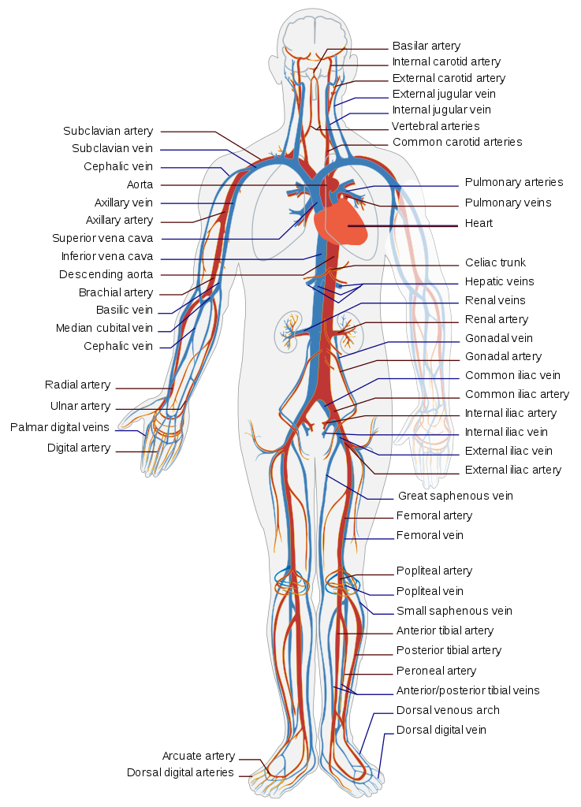
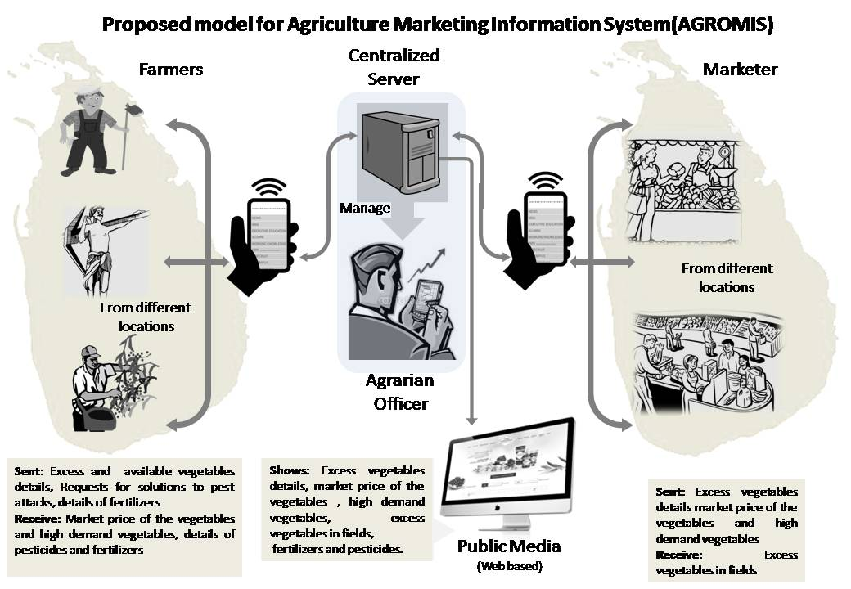
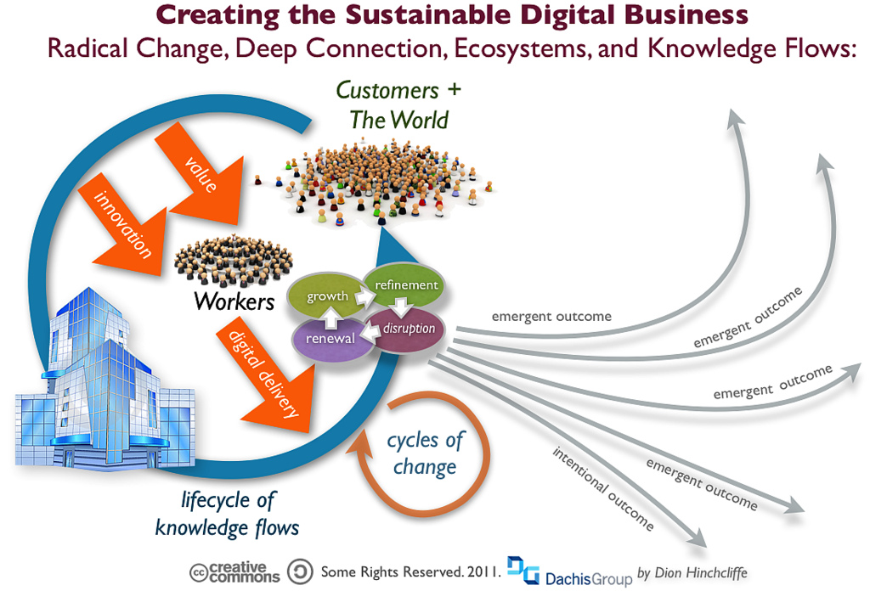
Notes:
Examples of systems can be found in ourselves, in nature, and in social and economic contexts.
https://www.google.com/url?sa=i&rct=j&q=&esrc=s&source=images&cd=&cad=rja&uact=8&ved=2ahUKEwjtru3Tpt7dAhUKMt8KHWInD6AQjhx6BAgBEAM&url=https%3A%2F%2Fcommons.wikimedia.org%2Fwiki%2FFile%3AAgriculture_Marketing_Information_System.jpg&psig=AOvVaw2xGazkjIpwGJVKXMZJkpcH&ust=1538244755203376
https://www.google.com/url?sa=i&rct=j&q=&esrc=s&source=images&cd=&cad=rja&uact=8&ved=2ahUKEwjw_oyLp97dAhUsTd8KHdInBJMQjhx6BAgBEAM&url=https%3A%2F%2Fwww.flickr.com%2Fphotos%2Fdionh%2F8225048690&psig=AOvVaw3p1ltTlcOJFpWncp60gdkU&ust=1538244671546732
https://www.google.com/url?sa=i&rct=j&q=&esrc=s&source=images&cd=&cad=rja&uact=8&ved=2ahUKEwjvweXBp97dAhVwTt8KHZWlCZIQjhx6BAgBEAM&url=https%3A%2F%2Fen.wikipedia.org%2Fwiki%2FCirculatory_system&psig=AOvVaw3zPvfhpTJ9C3egDrBd4G4L&ust=1538244529762339

Slide 8
The Watershed Learning Network System
Human Condition
Purpose of the systems model: Understanding the human condition in urban watersheds
Notes:
Flooding in urban watersheds is a common but very challenging problem faced by communities throughout the world. Often, persistent flooding problems compromises environmental quality and threatens human health. Therefore, this system produces changes in the quality of human life. We define that here as the human condition.

Slide 9
Map: Proctor Creek Stewardship Council
http://www.proctorcreek.org/
Image: K. Capps 2016, Proctor Creek Watershed, Atlanta
Notes:
For example, flooding in the Proctor Creek is a huge problem for communities in Atlanta. Human health and well-being and environmental quality in the Proctor Creek Watershed are being negatively influenced by flooding associated with increased runoff from rain and exposure to polluted stream water.

Slide 10
The Watershed Learning Network System
Purpose of the systems model: Understanding the human condition in urban watersheds
Notes:
There are many elements associated with urban watersheds and urban watershed management that affect the human condition. You can see some of them here. We do not assert that we have included all of the elements in this complex system. However, we have tried to identify some of the primary elements associated with the human condition in urban watersheds.
Our hope is that by engaging in these modules and by thinking of urban watersheds as complex, but definable systems, community members from around the US and throughout the world will be empowered with the knowledge to:
Restore and protect the ecological health of urban watersheds
Create conditions and opportunities to improve the quality of life of residents of urban watersheds
Facilitate equitable relationships between community stakeholders (public and private) that nurture cooperation, collaboration, and partnerships for projects integrating blue, green, and grey infrastructure to address flooding
Organize and advocate for an environment where every watershed is resilient to climate change
Promote city watershed programs that make a difference and advocate for a change of programs that do not provide sustainable solutions to water quality issues in urban environments, and
Develop a learning community devoted to learning about problem-solving for water quality and stormwater issues from an holistic, sustainable, and resilient perspectives.
As you proceed through the modules, we hope that you will grow to understand the connections between the social, economic, and environmental characteristics of urban watersheds.
We encourage you to, as you proceed through the program, to develop your own systems model. Consider what you would place in the center of your system. What do you want to understand? Flooding, human health, biodiversity, job opportunities in green infrastructure?
Once you have decided the purpose of your system, ask yourself, “What are the appropriate elements and interactions in the model, and what do you need to learn about the system in order to make the types of change you would like to see in the system?”
Next, consider what you have learned in the WLN that can help you design and understand your system.
Good luck on your journey.

