Slide 1
What is water infrastructure?
A Watershed learning network module
This material was generated as part of a collaboration between members of the Atlanta Watershed Learning Network and students and faculty of a service learning course in urban ecology. The views and opinions expressed in these materials are those of the authors and do not necessarily reflect the official policy or position of the University of Georgia.
Notes:
In this module, you will learn about water infrastructure; what it is, what it does, and why we need it.
This material was based on a curriculum developed by members of the Atlanta Watershed Learning Network, led by Dr. Yomi Noibi of Eco-Action.
Unless otherwise noted, all of the diagrams and models used in the modules were created by Diane Kelment, the video material was captured and edited in large part by Allison Krausman, and the images used in the modules were taken by the students or instructor of the urban ecology course at UGA in 2018 or the West Atlanta Watershed Alliance.

Slide 2
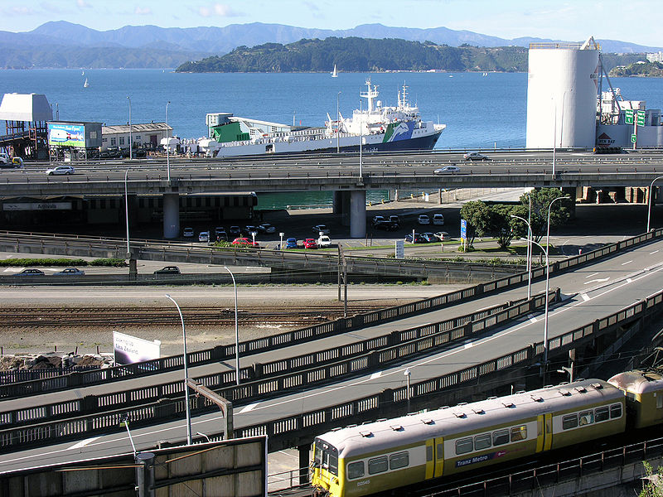
What is infrastructure?
The system of public works (also publicly owned utilities) of a country, state, or region ; also: the resources (as personnel, buildings, or equipment) required for an activity
Photo Credit: Phillip Capper
Notes:
The system of public works (also publicly owned utilities) of a country, state, or region ; also: the resources (as personnel, buildings, or equipment) required for an activity
Examples of infrastructure include streets and highways, sewers, water supply systems, electricity supply system, natural (or other types) gas supply system, and communications systems.

Slide 3
https://www.infrastructurereportcard.org/
Notes:
Across the country, America’s infrastructure is ageing and obsolete. The American Society of Civil Engineers gave American infrastructure an average rating of a D+.

Slide 4
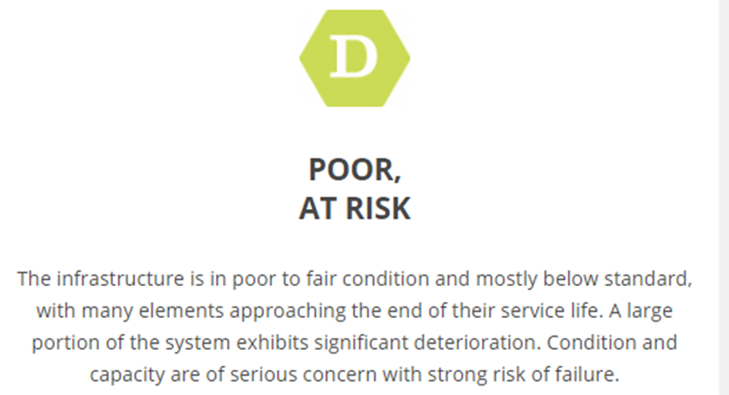
https://www.infrastructurereportcard.org/
Notes:
The infrastructure is in poor to fair condition and mostly below standard, with many elements approaching the end of their service life. A large portion of the system exhibits significant deterioration. Condition and capacity are of serious concern with strong risk of failure.

Slide 5
What are the differences between grey, green, and blue infrastructure?
Photo Credit: PA Environment Daily
Notes:
People often use the terms gray, green, and blue infrastructure when discussing watershed management in urbanizing areas.
Grey infrastructure includes the pipes, pumps, ditches, and detention ponds engineered by people to manage stormwater. https://www.soils.org/discover-soils/soils-in-the-city/green-infrastructure/important-terms/grey-infrastructure
“Green and blue infrastructure is to be understood as all natural and semi-natural landscape elements that (could) form a green-blue network. It can refer to landscape elements on various spatial scale levels: from individual rows of trees to complete valley systems. Examples of green landscape elements are hedgerows, copses, bushes, orchards, woodlands, natural grasslands and ecological parks. Blue landscape elements are linked to water. They can be pools, ponds and pond systems, wadis, artificial buffer basins or water courses. Together they form the green-blue infrastructure.”
https://green4grey.be/en/green-blue-infrastructure/what

Slide 6
https://www.infrastructurereportcard.org/
Notes:
“Drinking water is delivered via one million miles of pipes across the country. Many of those pipes were laid in the early to mid-20th century with a lifespan of 75 to 100 years. The quality of drinking water in the United States remains high, but legacy and emerging contaminants continue to require close attention.“
“The nation’s 14,748 wastewater treatment plants are the most basic and critical infrastructure systems for protecting public health and the environment. Years of treatment plant upgrades and more stringent federal and state regulations have significantly reduced untreated releases and improved water quality nationwide.”
https://www.infrastructurereportcard.org/cat-item/drinking-water/
https://www.infrastructurereportcard.org/cat-item/wastewater/

Slide 7
https://www.infrastructurereportcard.org/
Notes:
“While water consumption is down, there are still an estimated 240,000 water main breaks per year in the United States, wasting over two trillion gallons of treated drinking water. According to the American Water Works Association, an estimated $1 trillion is necessary to maintain and expand service to meet demands over the next 25 years.””
“It’s expected that more than 56 million new users will be connected to centralized treatment systems over the next two decades, requiring at least $271 billion to meet current and future demands. New methods and technologies turn waste into energy relying on the nation’s 1,269 biogas plants to help communities to better manage waste streams through reuse.”
https://www.infrastructurereportcard.org/cat-item/drinking-water/
https://www.infrastructurereportcard.org/cat-item/wastewater/

Slide 8
https://www.infrastructurereportcard.org/

Slide 9
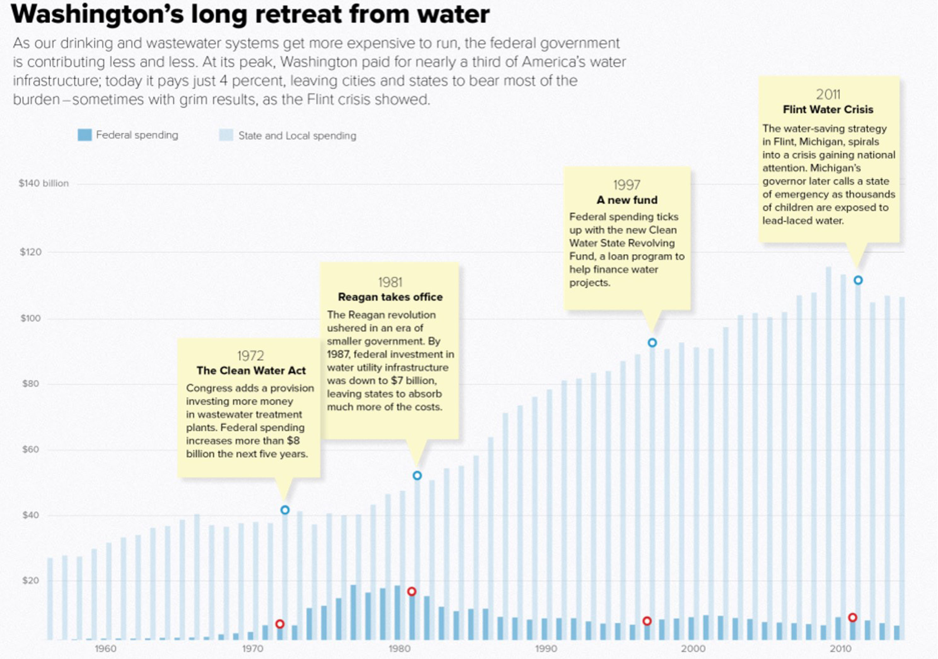
Vinik, Politco, 25 May 2016
Notes:
To pay for the majority of wastewater-treatment infrastructure (WWTI) in the US, Congress and the US Environmental Protection Agency administer funding through the Clean Water State Revolving Fund, part of the Clean Water Act 8; however federal funding for the Clean Water Act, has been reduced by 70% during the past 20 years. Therefore, state and local governments are frequently required to address the large gap between available federal funding and required costs 5.

Slide 10
Obsolete infrastructure is a big problem in the US
https://www3.epa.gov/region1/eco/uep/cso.html
Notes:
“Combined sewer systems are sewers that are designed to collect rainwater runoff, domestic sewage, and industrial wastewater in the same pipe. Most of the time, combined sewer systems transport all of their wastewater to a sewage treatment plant, where it is treated and then discharged to a water body. During periods of heavy rainfall or snowmelt, however, the wastewater volume in a combined sewer system can exceed the capacity of the sewer system or treatment plant. For this reason, combined sewer systems are designed to overflow occasionally and discharge excess wastewater directly to nearby streams, rivers, or other water bodies. These overflows, called combined sewer overflows (CSOs), contain not only storm water but also untreated human and industrial waste, toxic materials, and debris. They are a major water pollution concern for the approximately 772 cities in the U.S. that have combined sewer systems. CSOs may be thought of as a type of "urban wet weather" discharge. This means that, like sanitary sewer overflows (SSOs) and storm water discharges, they are discharges from a municipality's wastewater conveyance infrastructure that are caused by precipitation events such as rainfall or heavy snowmelt.”

Slide 11
References
12,000 Rain Gardens. (n.d.). Education centers of Northwest Stream Center and WSU Extension at McCollum Park, 600 128th St SE, Everett. Retrieved September 18, 2018, from http://www.12000raingardens.org/
American Rivers. (n.d.). What is Green Infrastructure? Retrieved September 18, 2018, from https://www.americanrivers.org/threats-solutions/clean-water/green-infrastructure/what-is-green-infrastructure/
American Society of Civil Engineers Report Card. 2017. https://www.infrastructurereportcard.org/
Environmental Protection Agency. (2018, July 03). What is Green Infrastructure? Retrieved September 18, 2018, from https://www.epa.gov/green-infrastructure/what-green-infrastructure
Svendsen, E., M.E. Northridge, S. S. Metcalf. 2012. Integrating Grey and Green Infrastructure to Improve the Health and Well-being of Urban Populations. Cities and the Environment. 5: Article 3: https://digitalcommons.lmu.edu/cate/vol5/iss1/3/
The USGS Water Science School: https://water.usgs.gov/edu/hydrology.html

